Slide 1
PROJECT 4A :
A NOOK TO INSPIRE
Name : NG PUI YEEN
Matric No : 103724
Course : Construction Management
Issued Date : 10 August 2009
Submission Date : 13 August 2009

Slide 2
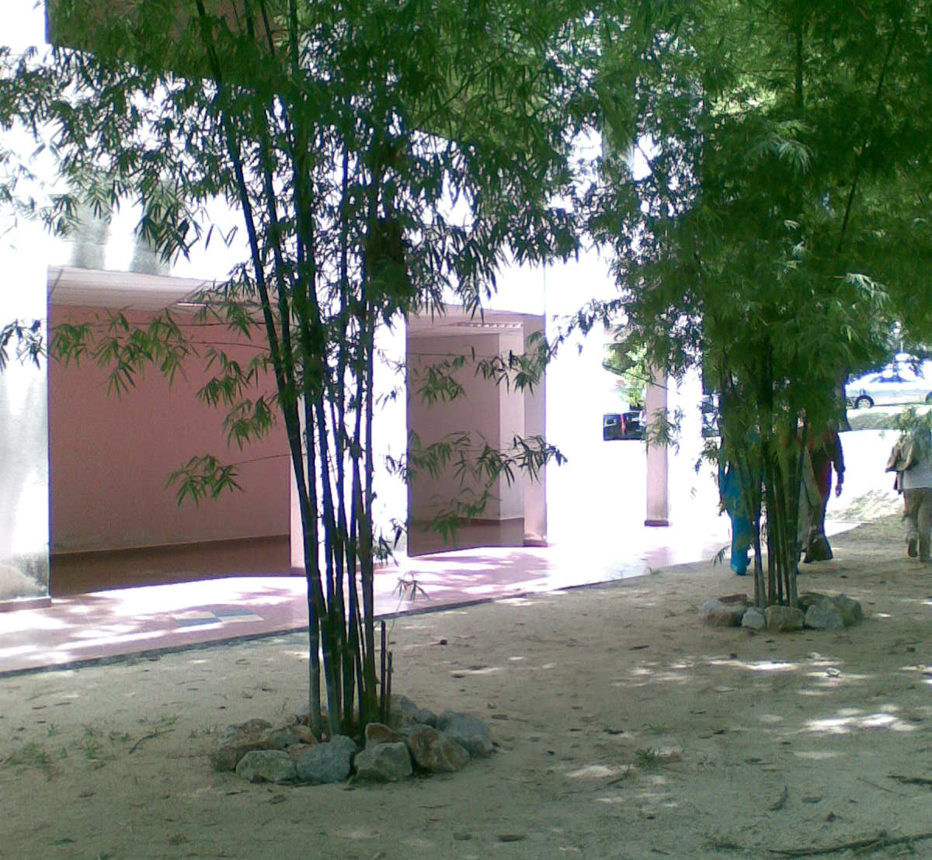
MY SITE
I choose in front of E48B as my location for my personal space. I feel that place is shady and cool for me to relax, put my feet up and have a break. I also feel familiar with that place because I will pass through that place when I came HBP school for my lecture class. That place is nice and warm for me.

Slide 3
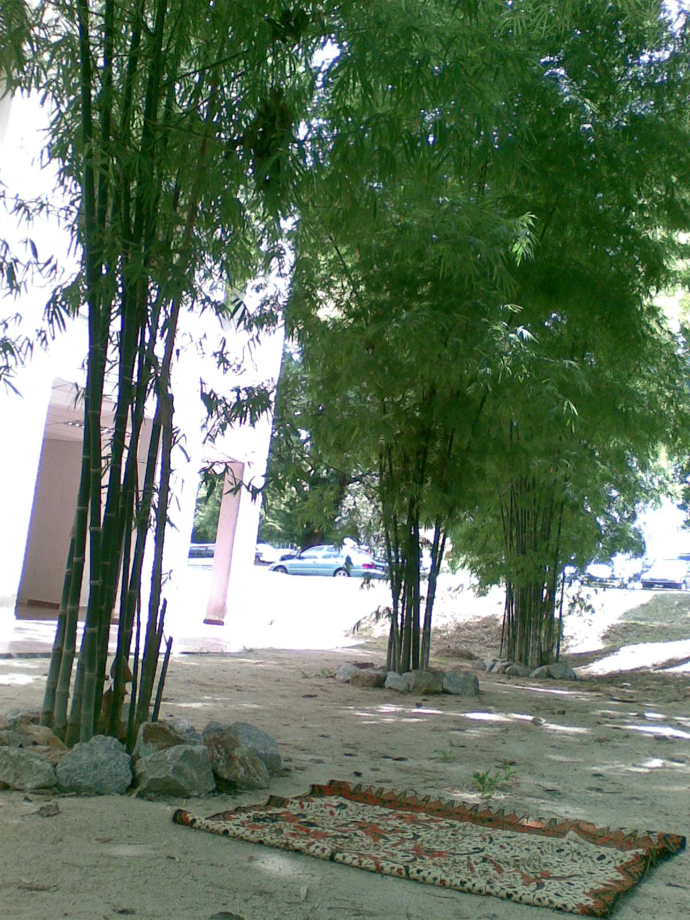
I place my sarong beside the bamboo tree because I feel comfortable here. I feel this place is suitable for me to rest.

Slide 4
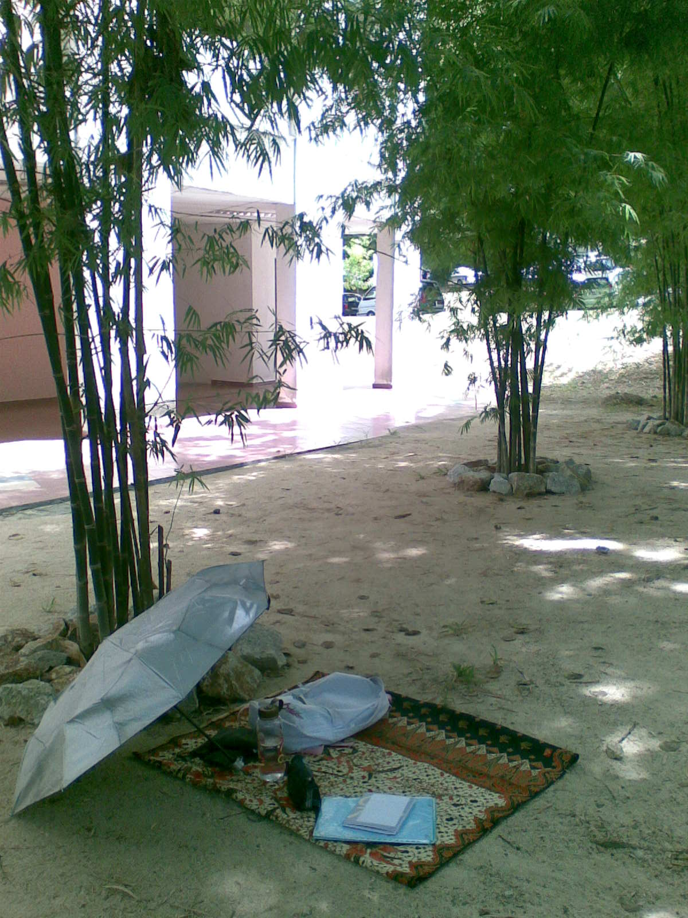
Placing my belongings at my sarong there. Leaving a place for me to sit and lie at there.

Slide 5
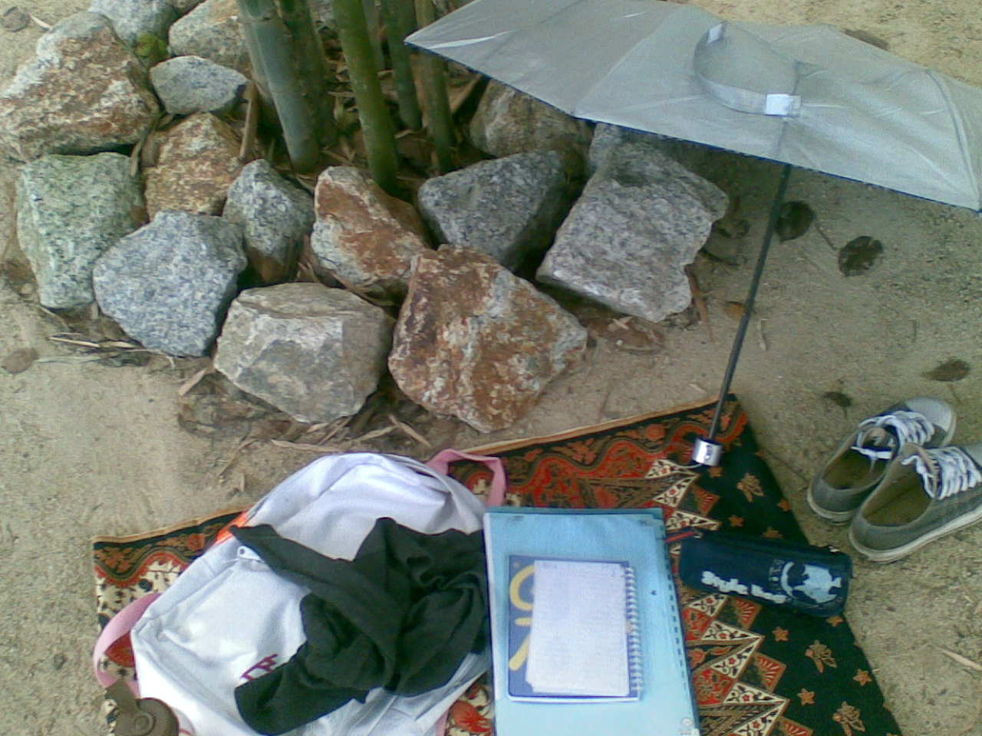
My Belongings

Slide 6
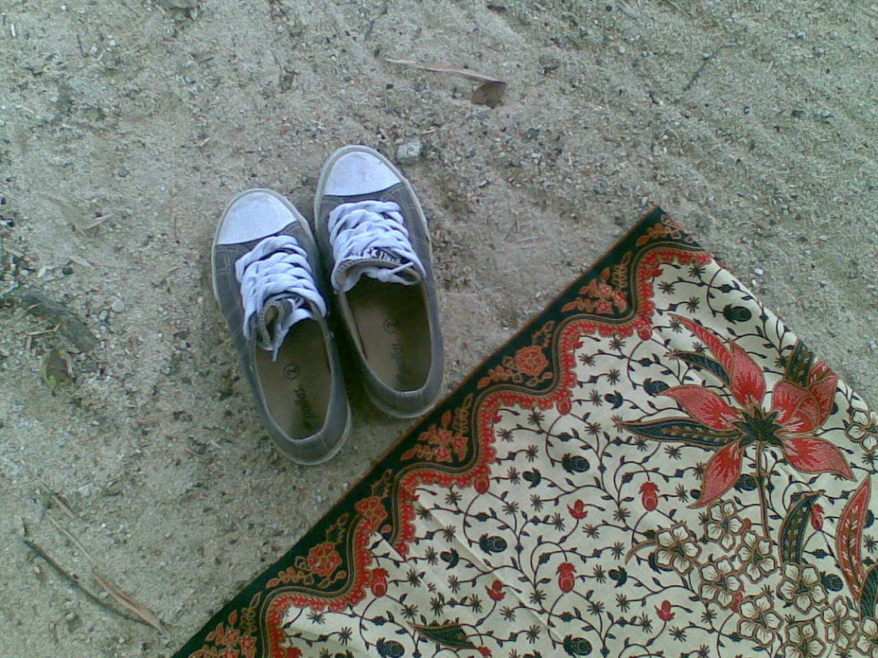
Taking off my shoes and put it beside my sarong…

Slide 7
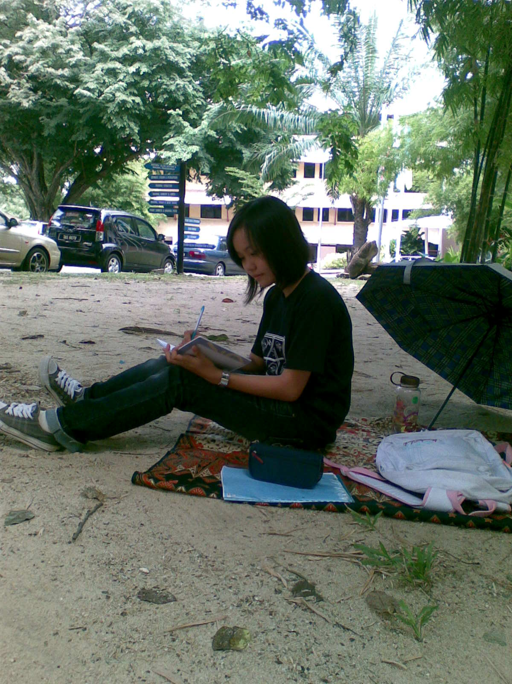
Can do some simple work at my personal place.

Slide 8
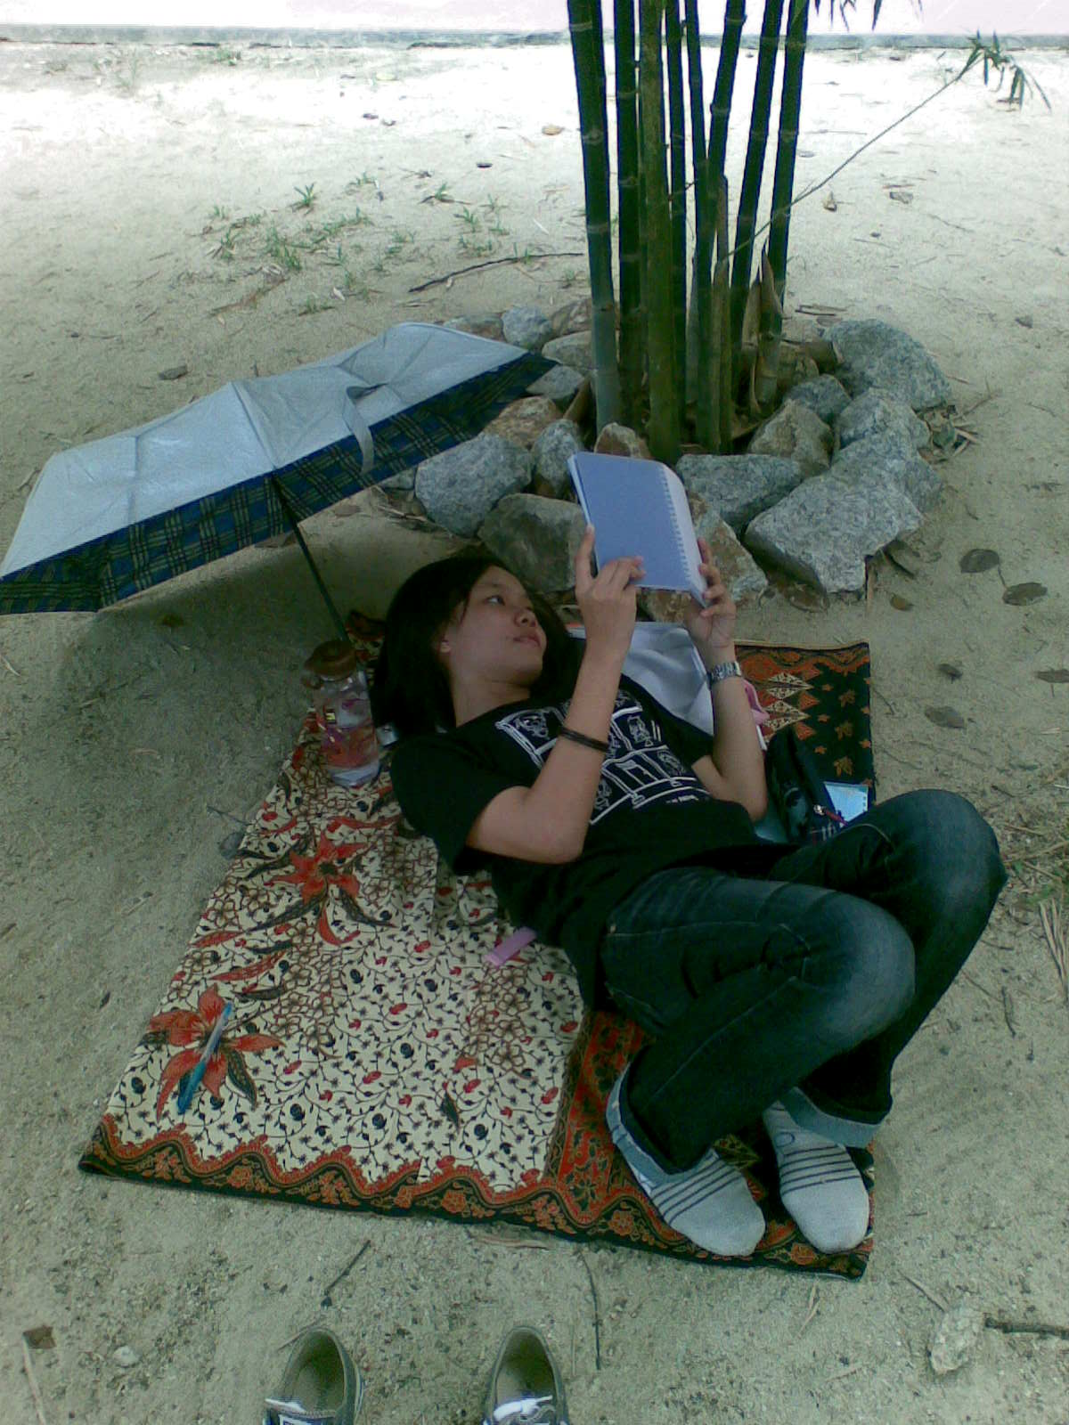
Lying at my sarong and reading some book.

Slide 9
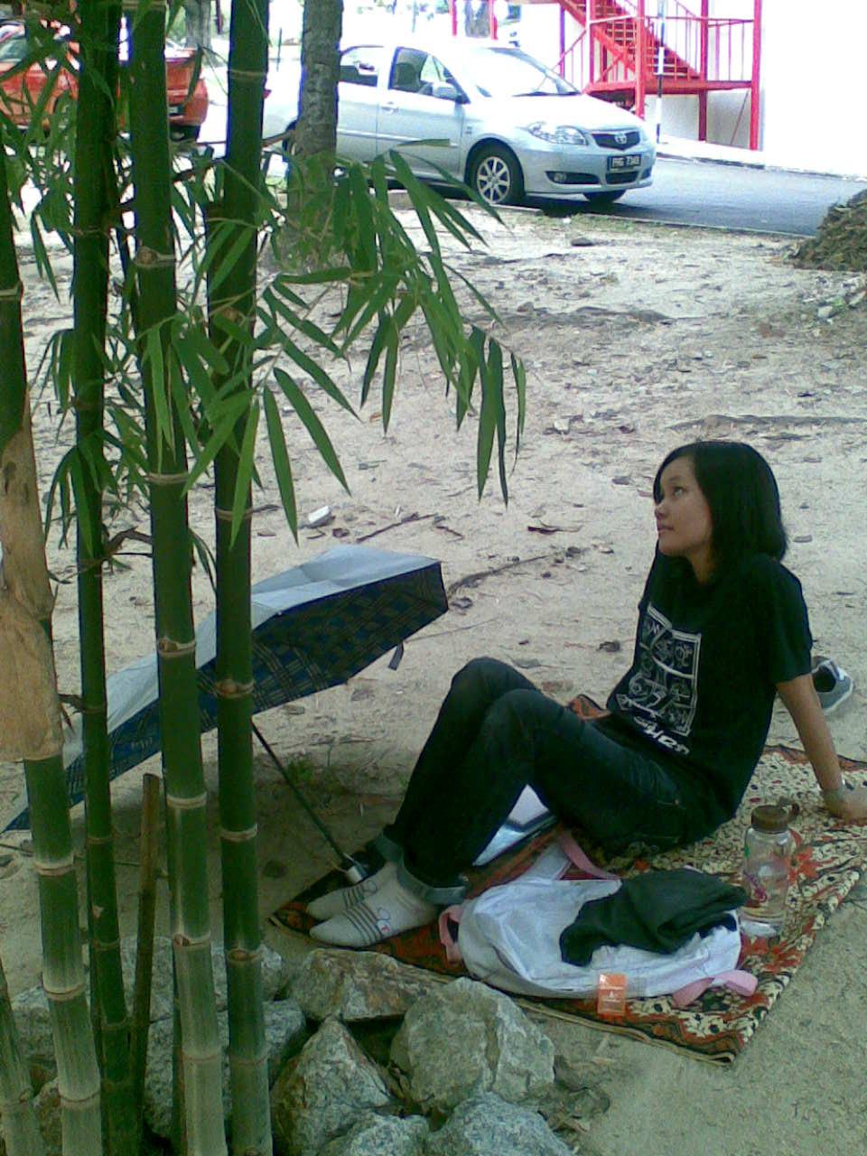
I can sit at my sarong and to be lost in reverie.

Slide 10
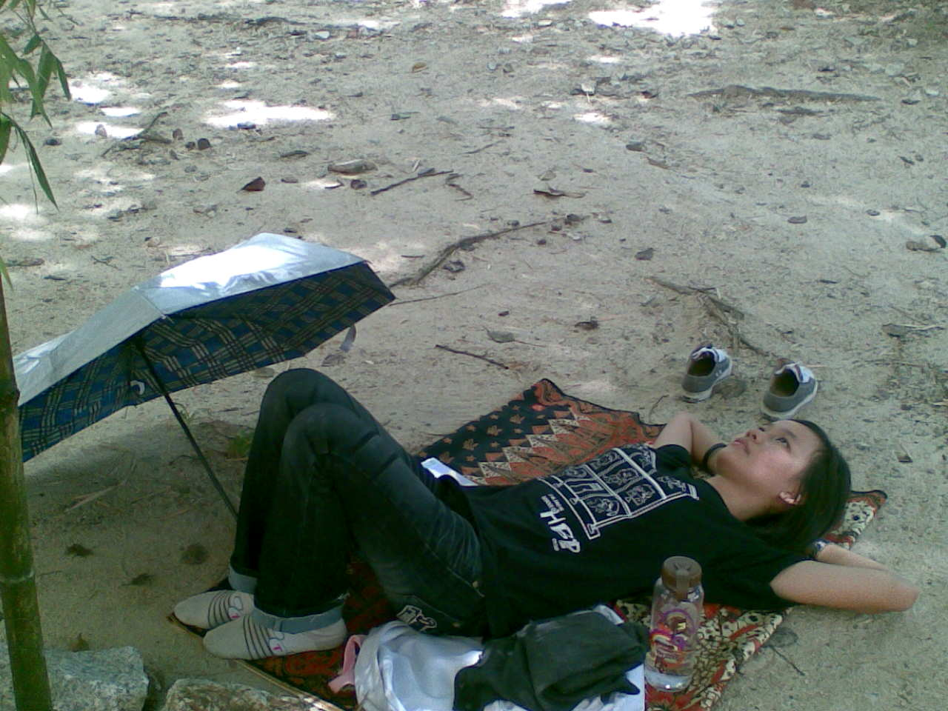
I can also lying at my sarong and look at the sky. Start dreaming…

Slide 11
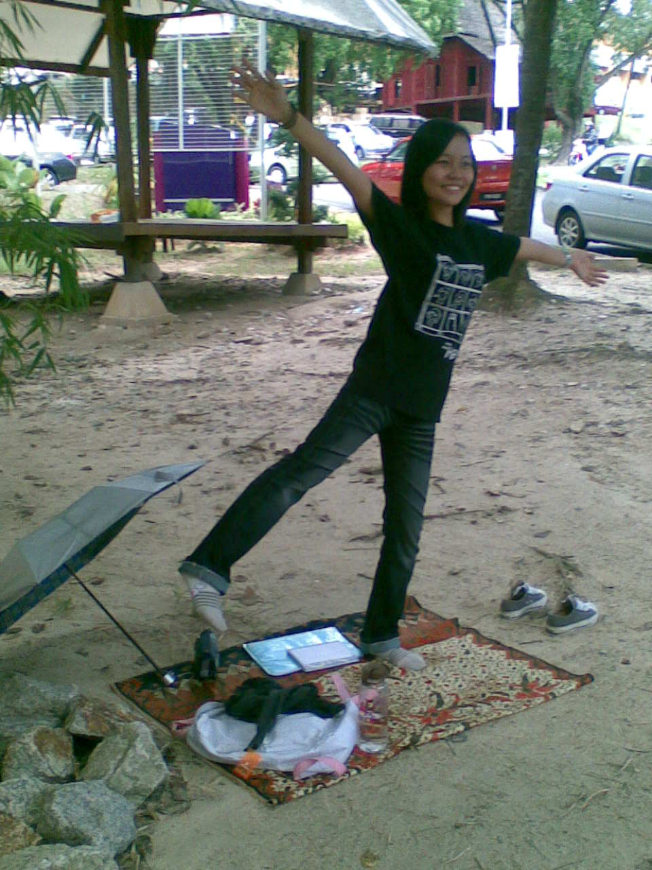
Enjoying at my personal space…

Slide 12
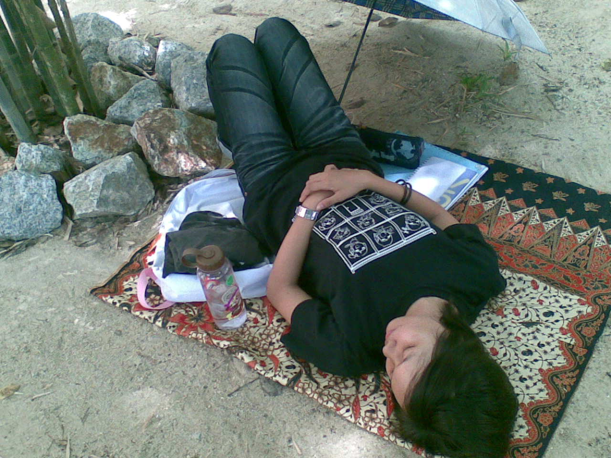
When I feel tired, I can have a nap at my sarong here. Close my eyes, lying at the sarong and relax…

Slide 13
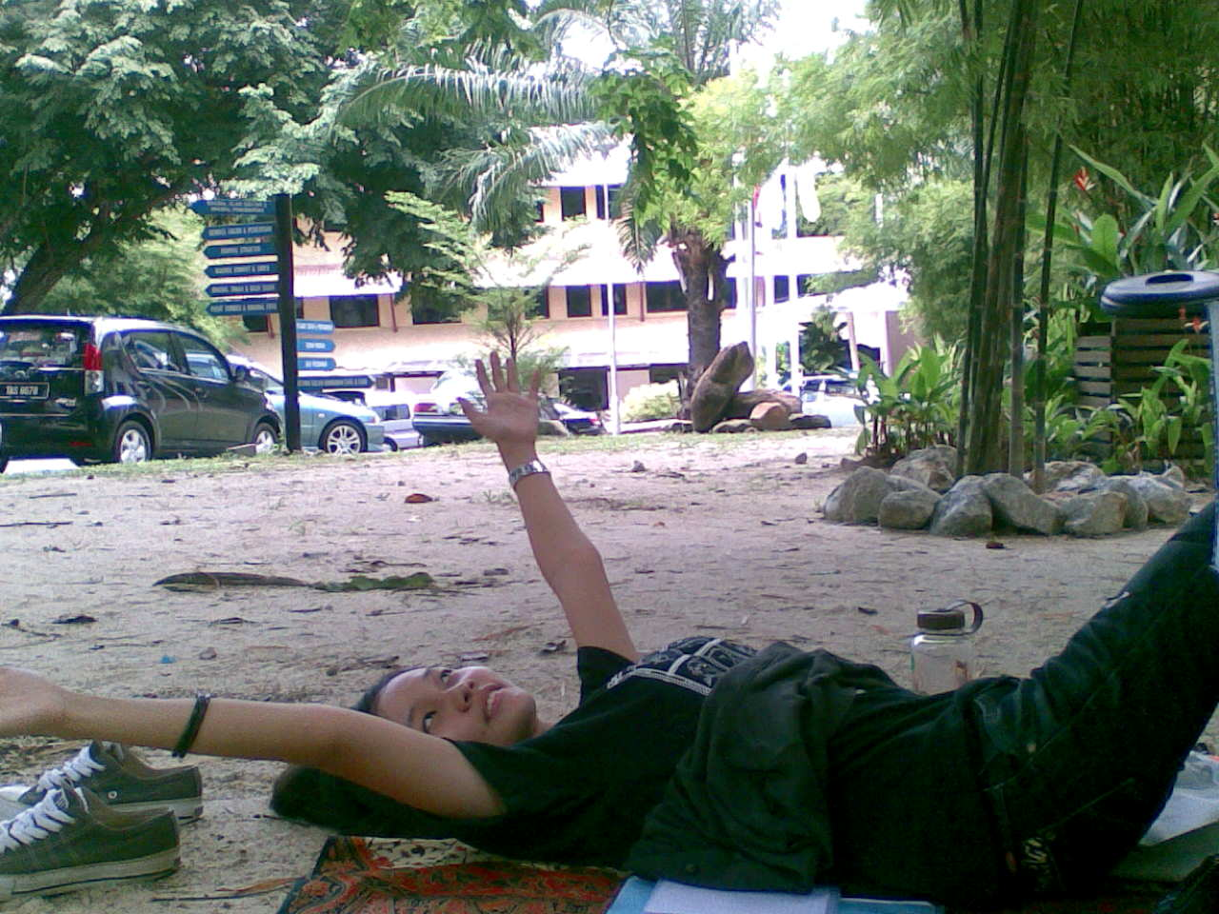
After I having a nap, take a deep breath and start to do my work again.

Slide 14
This is a suitable place for me to relax at here. I also can release my stress and tension at here. Hope the others also feel the same and can relax at my personal space too. Enjoy…
The End!!!

